Slide 1
DEFENSE STRATEGIES

Slide 2
These adversarial examples are hard to defend because of the following reasons:
(1) A theoretical model of the adversarial example crafting process is very difficult to construct.
-complex optimization process which is non-linear and non-convex for most Machine Learning models.
-The lacking of proper theoretical tools to describe the solution to these complex optimization problems make it even harder to make any theoretical argument that a particular defense will rule out a set of adversarial examples.
(2) Machine Learning models are required to provide proper outputs for every possible input.
A considerable modification of the model to incorporate robustness against the adversarial examples may change the elementary objective of the model.
(model ne robust banava jata main objective j bhatkai jase)

Slide 3
Ref
Adversarial Attacks and Defences: A Survey, https://arxiv.org/pdf/1810.00069.pdf.
2. Ian J. Goodfellow, Jonathon Shlens, and Christian Szegedy. 2014. Explaining and Harnessing Adversarial Examples. CoRR abs/1412.6572 (2014). http://arxiv.org/abs/1412.6572

Slide 4
Challenges
Most of the current defense strategies are not adaptive to all types of adversarial attack as one method may block one kind of attack but leaves another vulnerability open to an attacker (koi pan model badha attack thi bachi na shake)
implementation of such defense strategies may incur performance overhead, and can also degrade the prediction accuracy of the actual model. (model ne robust bana jata accuracy ni pathari fari vadse)

Slide 5
Solution 1: Adversarial Training
[The primary objective of the adversarial training is to increase model robustness by injecting adversarial examples into the training set]

Slide 6
Adversarial training is a standard brute force approach where the defender simply generates a lot of adversarial examples and augments these perturbed data while training the targeted model.
The augmentation can be done either by feeding the model with both the original data and the crafted data, or by learning with a modified objective function given by [2]

Slide 7

Equation Details
J : the original loss function.
The central idea behind this strategy is to increase model's robustness by ensuring that it will predict the same class for legitimate as well as perturbed examples in the same direction.

Slide 8
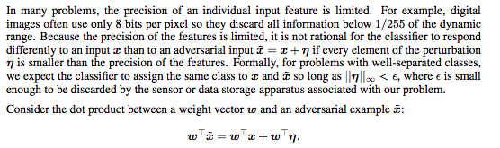
LINEAR EXPLANATION OF ADVERSARIAL EXAMPLES [2]

Slide 9
LINEAR EXPLANATION OF ADVERSARIAL EXAMPLES [2]
for problems with well-separated classes, we expect the classifier to assign the same class to x and x˜ so long as ||η||∞ < , ε.
We can maximize this increase subject to the max norm constraint on η by assigning η = sign(w).
If w has n dimensions and the average magnitude of an element of the weight vector is m, then the activation will grow by εmn.
Since ||η||∞ does not grow with the dimensionality of the problem but the change in activation caused by perturbation by η can grow linearly with n, then for high dimensional problems, we can make many infinitesimal changes to the input that add up to one large change to the output

Slide 10
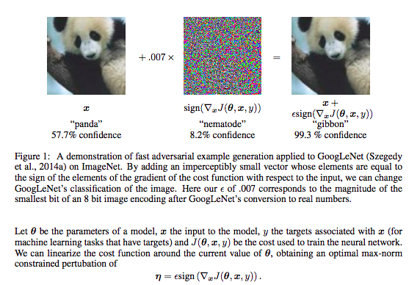

Slide 11
Equation Details
J : the original loss function.
Modified the original cost function with adversarial inputs in training.

Slide 12
Additional instances are crafted using one or multiple following attack strategies
How to modify samples so that a classification model yields an adversarial output?

Slide 13
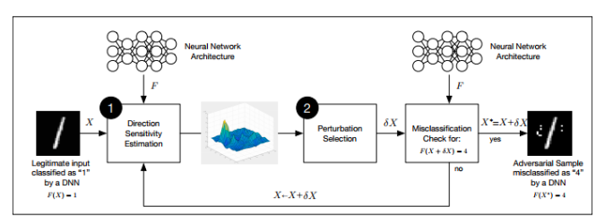
Testing Phase Generation
How adversaries craft adversarial samples in a white-box setup.
Papernot et al. [62] introduced a general framework :
The framework is split into two phases: a) direction sensitivity estimation and b) perturbation selection

Slide 14
Direction Sensitivity Estimation: The adversary evaluates the sensitivity of a class
change to each input feature by identifying directions in the data manifold around sample
X in which the model F , learned by the DNN is most sensitive and likely to result in a class
change.

Slide 15
Perturbation Selection: The adversary then exploits the knowledge of sensitive information to select a perturbation δX among the input dimensions in order to obtain an adversarial perturbation which is most efficient.

Slide 16
Both the steps are repeated by replacing X with X +δX before the start of each new iteration,until the adversarial goal is satisfied by the perturbed sample.
Total perturbation used for crafting the adversarial sample from a valid example needs to be as minimum as possible. This is necessary for the adversarial samples to remain undetected in human eyes.

Slide 17


How to find an approximate solution to this optimization problem using each of the two steps?

Slide 18
Direction Sensitivity Estimation.
In this step, the adversary considers a legitimate sample X,an n-dimensional input vector.
The objective here is to find those dimensions of X which will produce an expected adversarial performance with the smallest selected perturbation.
This can be achieved by changing the input components of X and evaluating the sensitivity of the trained DNN model F for these changes.

Slide 19
Different Methods for Sensitivity Analysis

Slide 20

L-BFGS: Szegedy et al. [70] first introduced the term adversarial sample by formalizing the following minimization problem as the search for adversarial examples.
The input example x, which is correctly classified by f, is perturbed with r to obtain the resulting adversarial example x∗ = x + r.
The perturbed sample remains in the input domain D, however, it is assigned the target label l.
Gives good performance, but it is computationally expensive while calculating adversarial samples.

Slide 21
Why the name L-BFGS?
Broyden–Fletcher–Goldfarb–Shanno (BFGS) algorithm is an iterative method for solving unconstrained nonlinear optimization problems.
L indicates: Limited-memory BFGS

Slide 22

Fast Gradient Sign Method (FGSM):
fast gradient sign methodology which calculates the gradient of the cost function with respect to the input of the neural network.
adversarial examples are generated using the following equation:

Slide 23

Target Class Method:
maximizes the probability of some specific target classt , which is unlikely the true class for a given example.
The adversarial example is crafted using the following equation:

Slide 24
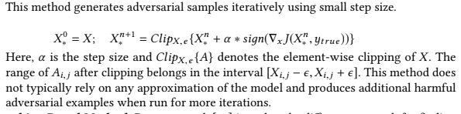
Basic Iterative Method:

Slide 25
Jacobian Based Method

Slide 26
Perturbation Selection
An adversary may use the information about network sensitivity for input differences in order to evaluate the dimensions which are most likely to generate the target misclassification with minimum perturbation.

Slide 27
Perturb all the input dimensions:
Perturb every input dimensions but with a small quantity in the direction of the sign of the gradient calculated using the FGSM method.
This method efficiently minimizes the Euclidean distance between the original and the corresponding adversarial samples.

Slide 28
Perturb a selected input dimensions:
Involves saliency maps to select only a limited number of input dimensions to perturb.
The objective of using saliency map is to assign values to the combination of input dimensions which indicates whether the combination if perturbed, will contribute to the adversarial goals.
This method effectively reduces the number of input features perturbed while crafting adversarial examples.
For choosing the input dimensions which forms the perturbations, all the dimensions are sorted in decreasing order of adversarial saliency value.

Slide 29
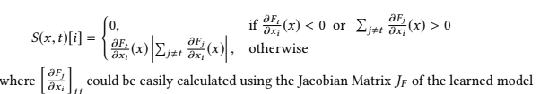
The saliency value S(x,t)[i] of a component i of a legitimate example x for a target class t is evaluated using the following equation:

Slide 30
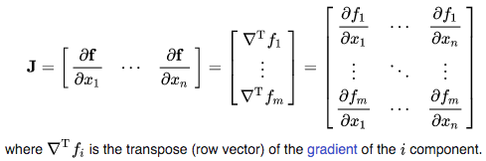
Jacobian matrix is a matrix of partial derivatives.
Jacobian is the determinant of the jacobian matrix.
The matrix will contain all partial derivatives of a vector function.

Slide 31
The saliency value S(x,t)[i] of a component i of a legitimate example x for a target class t is evaluated using the following equation:

Slide 32
Advantages and Drawbacks
The first method (FDGM) is well fitted for the fast crafting of many adversarial samples but with a relatively large perturbation and thus is potentially easier to detect.
The second method (Saliency) reduces the perturbations at the expense of a higher computing cost.

Slide 33
Adversarial examples in a black-box setting.

Slide 34
in the case of an adaptive black-box scenario, the adversary does not have access to a large dataset and thus augments a partial or randomly selected dataset by selectively querying the target model as an oracle.
-train a local substitute model which approximates the decision boundary of the target model. Once the local model is trained with high confidence, any of the white-box attack strategies can be applied.
Eg: One of the popular method of dataset augmentation- Jacobian based Data Augmentation.

Slide 35
Jacobian based Data Augmentation.
An adversary could potentially make an infinite number of queries to get the Oracle’s output O(x) for any input x.
This would provide the adversary a copy of the oracle. However, the process is not tractable considering the continuous domain of an input to be queried.
Furthermore, making a significant number of queries presents the adversarial behavior easy to detect. (as normal loko to atli badhi query nathi karvana)

Slide 36
Hence, the greedy heuristic that an adversary follow is to prioritize the samples while querying the oracle for labels to get a substitute DNN F approximating the decision boundaries of the Oracle.
These directions can be identified with the substitute DNN's Jacobian matrix JF , which is evaluated at several input points x.
Precisely,the adversary evaluates the sign of the Jacobian matrix dimension corresponding to the label assigned to input x by the oracle, denoted by sдn (JF (x) [O(x)]).
The term λ∗sдn (JF (x) [O(x)]) is added to the original datapoint, to obtain a new synthetic training point.
The iterative data augmentation technique can be summarized using the following equation.

Slide 37
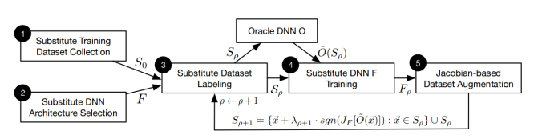
*https://dl.acm.org/doi/pdf/10.1145/3052973.3053009

Slide 38
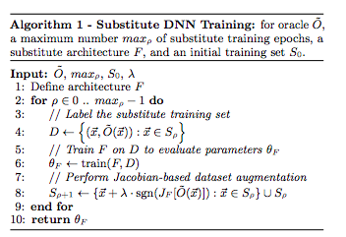
*https://dl.acm.org/doi/pdf/10.1145/3052973.3053009

Slide 39
Here, the limitation is placed on the substitute:
it must model a differentiable function—to allow for synthetic data to be generated with its Jacobian matrix.

Slide 40
Gradient Hiding
A natural defense against gradient-based attacks [e.g FGSM too]:
could consist in hiding information about the model’s gradient from the adversary if the model is non-differentiable
(e.g, a Decision Tree, a Nearest Neighbor Classifier, or a Random Forest),
gradient-based attacks are rendered ineffective in such cases.
[However,this defense are easily fooled by learning a surrogate Black-Box model having gradient and crafting examples using it.]

Slide 41
Privacy-Preserving Machine Learning

Slide 42
According to member inference attack mentioned], malicious users in the training might use the plaintext gradient to train a shadow model to compromise the data security of other users.
Thus, homomorphic encryption against this attack, allows one to perform calculations on encrypted gradients without decrypting it.

Slide 43
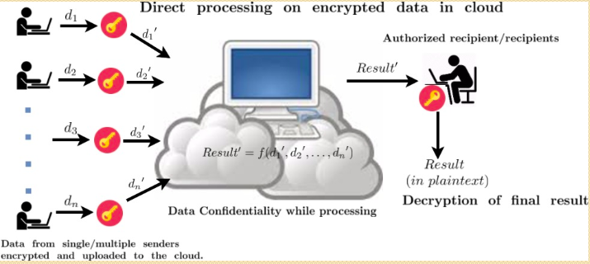
The privacy-preserving issue is one of the most practical problems for machine learning recently.
Fully homomorphic encryption (FHE) is one appropriate tool for privacy-preserving machine learning (PPML) to ensure strong security in the cryptographic sense.

Slide 44
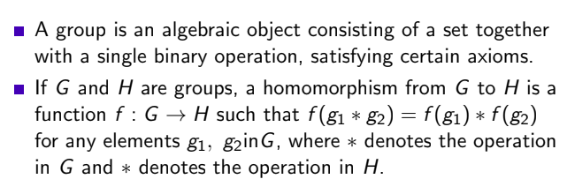
What is homomorohism?

Slide 45
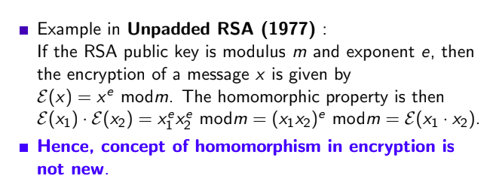
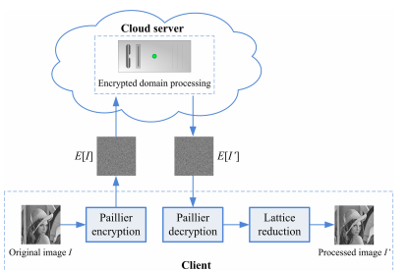
Homomorphism and Encryption

Slide 46
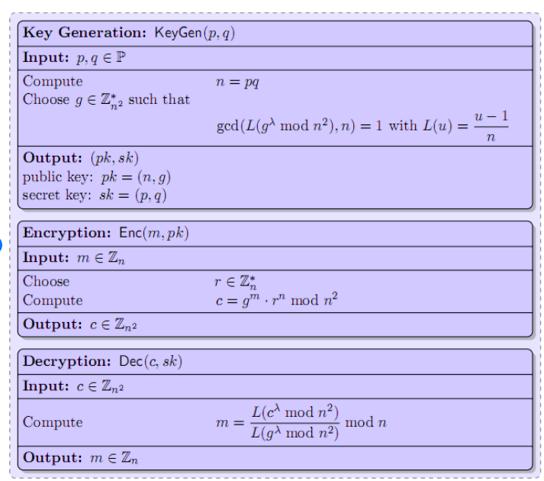
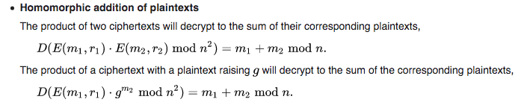
Paillier Encryption

Slide 47
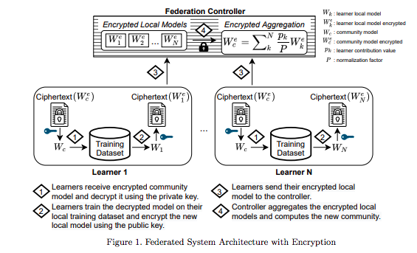
Application in Federated Learning*
*Secure Neuroimaging Analysis using Federated Learning with Homomorphic Encryption, SIPAIM 2021

Slide 48
Code References
https://github.com/data61/python-paillier/blob/master/examples/alternative_base.py
https://github.com/data61/python-paillier/blob/master/examples/federated_learning_with_encryption.py

Slide 49
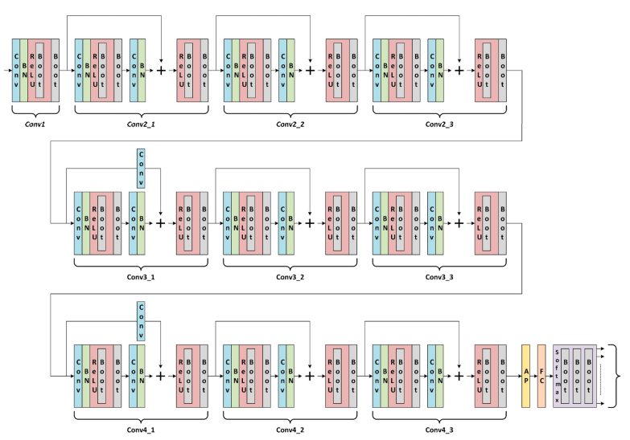
Resnet 20: How to compute in ciphertext domain?

